Slide 1
MALCOM Machine Learning for Communication Systems Lecture 9 Distributed Machine Learning Spring 2024
Jaiprakash Nagar
(Slides: Marios Kountouris)

Slide 2
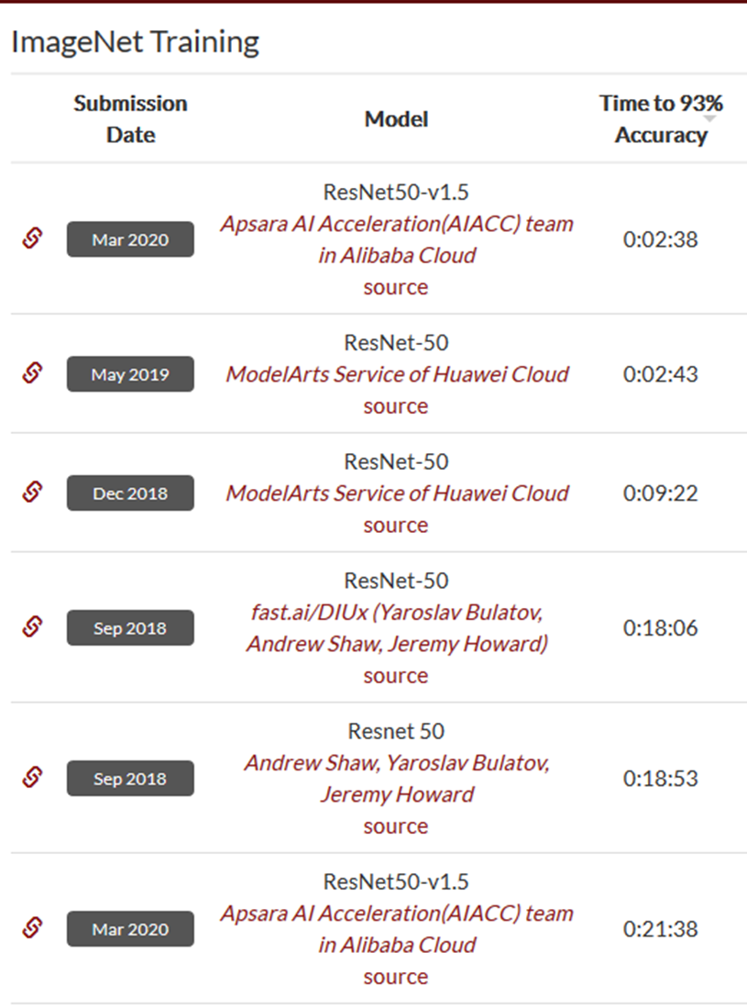
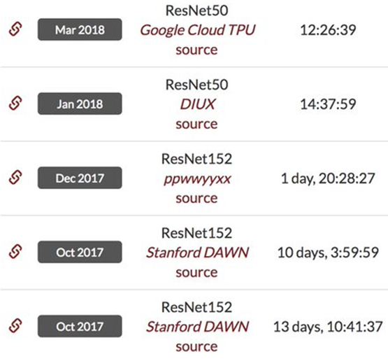
So far…
… we have talked about algorithms and techniques
… we have seen ways to optimize their parameters
How should we implement our algorithms to best utilize our resources?
Which is the right architecture for our ML algorithms?
How about hardware? How does it affect the performance and the design options?
Main Issues in Large-Scale ML (massive datasets):
Storage
Computation
Communication (in distributed settings)
Goal: Speed up Machine Learning
Key Approach: Train at Scale
https://dawn.cs.stanford.edu/benchmark/index.html
Notes:
Ajouter une photo d’un vieux telegraphe, puis un mobile satellitte ancienne generation…can someone find an even older wireless communication system (smoke)

Slide 3
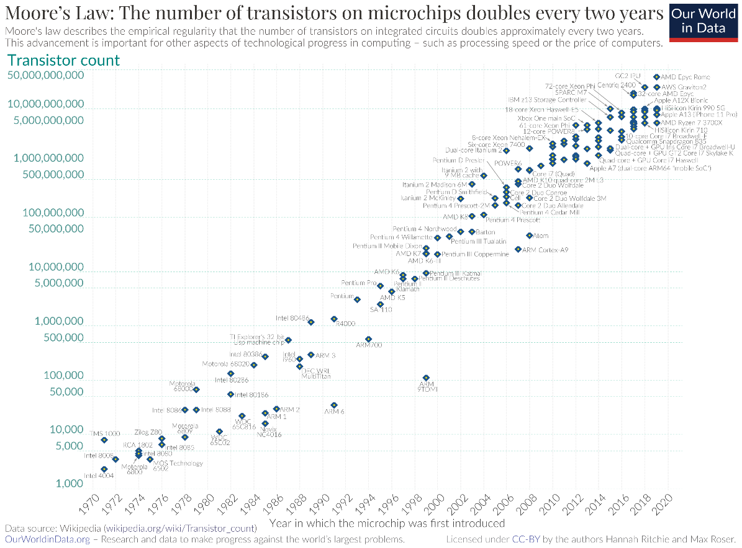
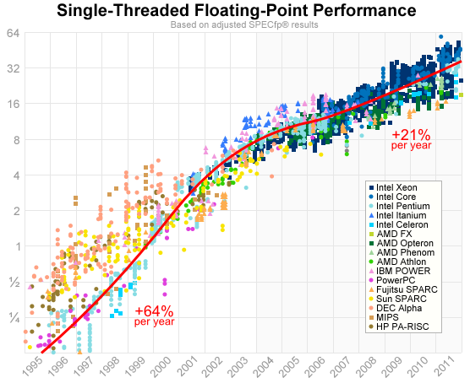
Computing Performance - the Good Old Days
G. Moore’s “Law”
Usually cast as “X doubles every 18-24 months”.
Q: What is X?
Computer performance
CPU Clock speed
Number of transistors per chip
One of the above, at constant cost?
~ 50 years of exponential computing performance growth
Remarkable but difficult to maintain!!
https://preshing.com/20120208/a-look-back-at-single-threaded-cpu-performance/
Notes:
Ajouter une photo d’un vieux telegraphe, puis un mobile satellitte ancienne generation…can someone find an even older wireless communication system (smoke)

Slide 4
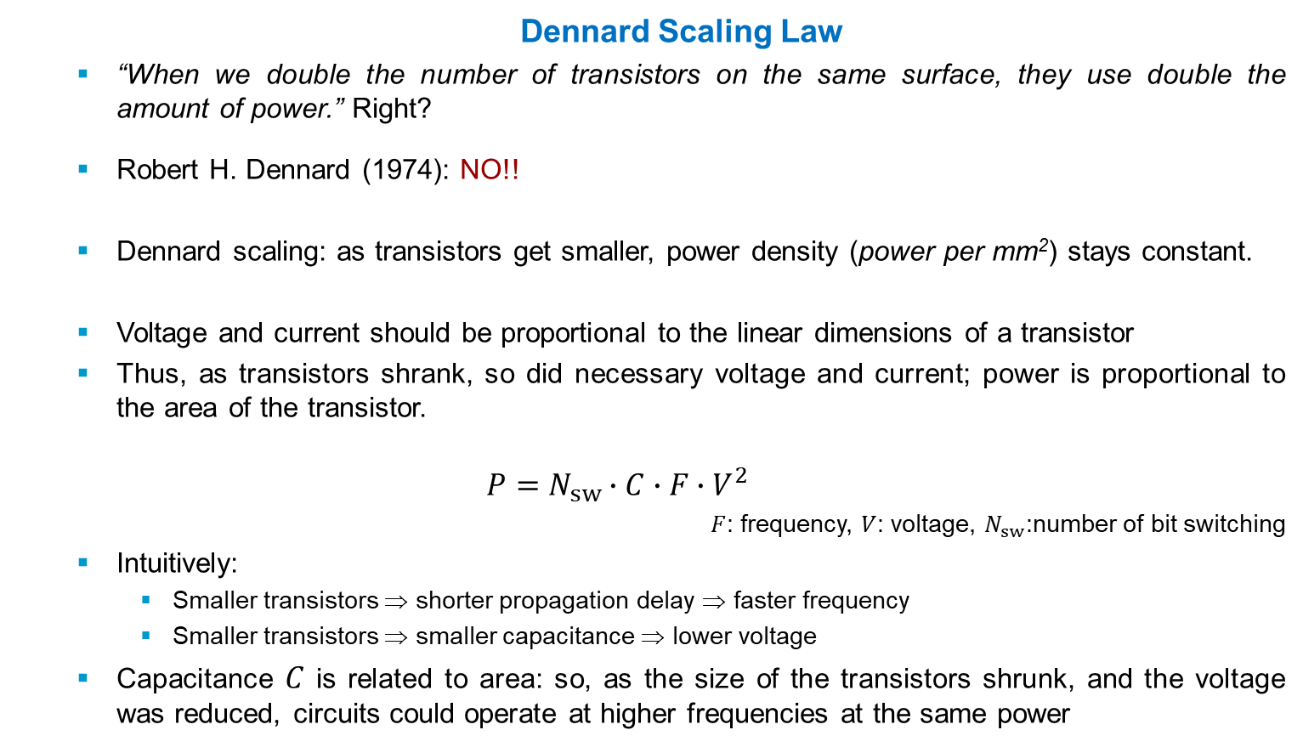
Computing Performance - the Good Old Days
Dennard Scaling Law
“When we double the number of transistors on the same surface, they use double the amount of power.” Right?
Robert H. Dennard (1974): NO!!
Dennard scaling: as transistors get smaller, power density (power per mm²) stays constant.
Voltage and current should be proportional to the linear dimensions of a transistor
Thus, as transistors shrank, so did necessary voltage and current; power is proportional to the area of the transistor.
$$P=N_{sw}∙C∙F∙V^{2}$$
$F$: frequency, $V$: voltage, $N_{sw}$:number of bit switching
Intuitively:
Smaller transistors ⇒ shorter propagation delay ⇒ faster frequency
Smaller transistors ⇒ smaller capacitance ⇒ lower voltage
Capacitance $C$ is related to area: so, as the size of the transistors shrunk, and the voltage was reduced, circuits could operate at higher frequencies at the same power
Notes:
Ajouter une photo d’un vieux telegraphe, puis un mobile satellitte ancienne generation…can someone find an even older wireless communication system (smoke)

Slide 5
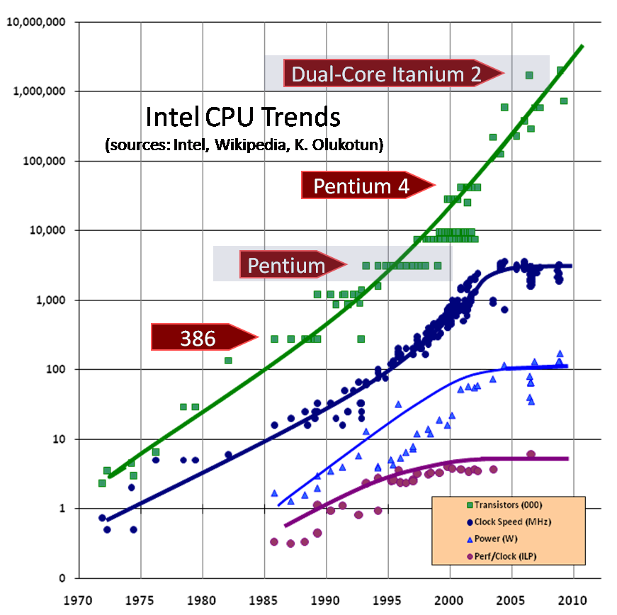
Computing Performance - the Good Old Days are Over
Free Performance Lunch is over!
(Herb Sutter 2005)
Only transistor density still increasing exponentially
All other trends start to flatten out
Power Wall
End of Dennard scaling: no longer fixed power/area
Dennard scaling ignored the “leakage current” and “threshold voltage”
Too much heat to dissipate at high clock frequencies – chip will melt
From 90nm and smaller, transistors would leak part of their power into the substrate of the processor ⇒ chip heats up
Putting a sufficiently large # “leaky” transistors together, the chip overheats
Notes:
Ajouter une photo d’un vieux telegraphe, puis un mobile satellitte ancienne generation…can someone find an even older wireless communication system (smoke)

Slide 6
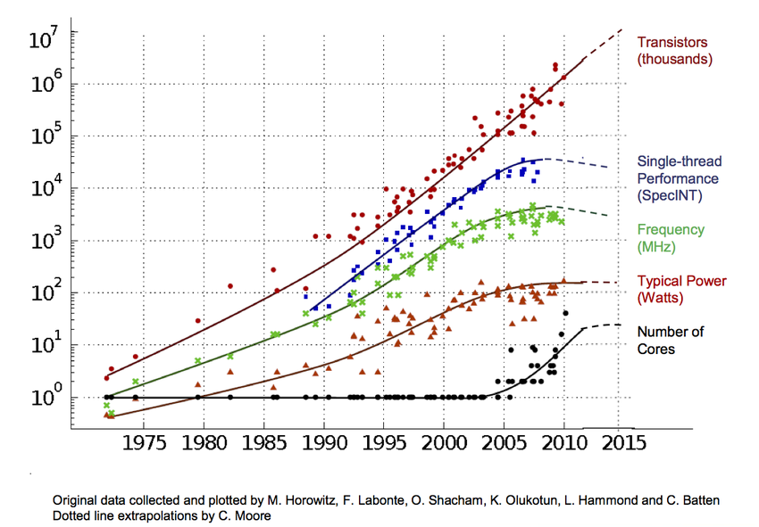
But Moore’s “Law” continues
Single-thread (single-core) performance growth ended
Frequency scaling ended (Dennard scaling) ~ 4GHz
Instruction-level parallelism (perf/clock) scaling stalled
What do we do with all these transistors?
Performance improvements are now coming from the increase in the number of cores on a processor (ASIC)
#cores per chip doubles every 18 months instead of clock
Multiple (simple) cores at lower clock frequency are more power efficient
End of era of Sequential Computing … Time for Parallel Computing
Notes:
Ajouter une photo d’un vieux telegraphe, puis un mobile satellitte ancienne generation…can someone find an even older wireless communication system (smoke)

Slide 7
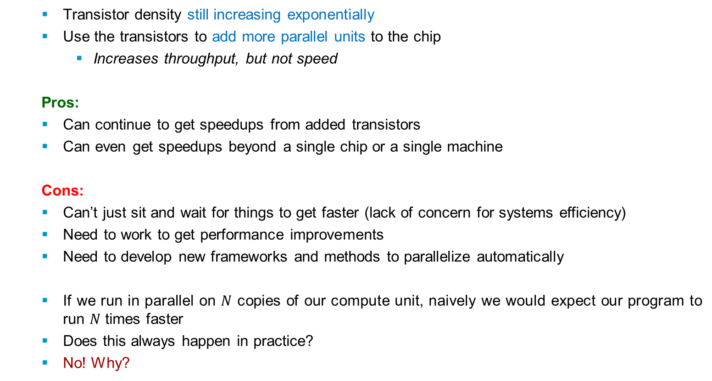
Parallelism
Transistor density still increasing exponentially
Use the transistors to add more parallel units to the chip
Increases throughput, but not speed
Pros:
Can continue to get speedups from added transistors
Can even get speedups beyond a single chip or a single machine
Cons:
Can’t just sit and wait for things to get faster (lack of concern for systems efficiency)
Need to work to get performance improvements
Need to develop new frameworks and methods to parallelize automatically
If we run in parallel on $N$ copies of our compute unit, naively we would expect our program to run $N$ times faster
Does this always happen in practice?
No! Why?
Notes:
Ajouter une photo d’un vieux telegraphe, puis un mobile satellitte ancienne generation…can someone find an even older wireless communication system (smoke)

Slide 8
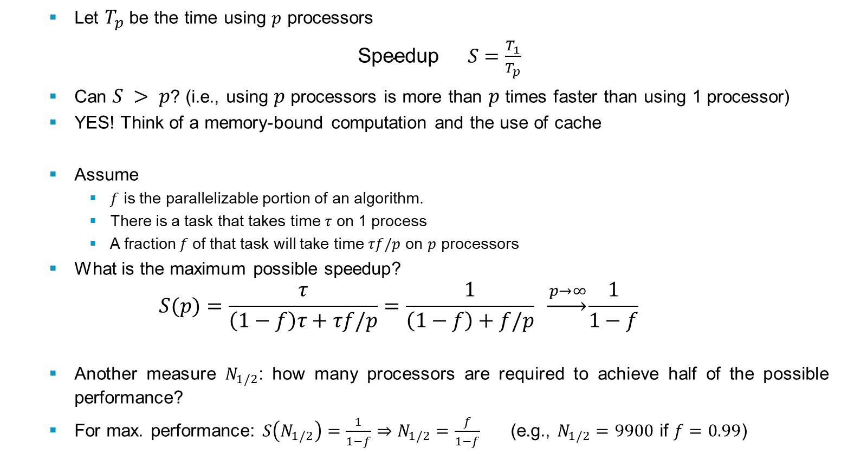
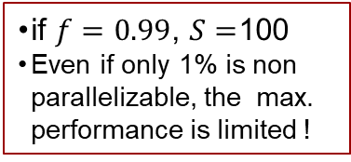
Amdahl’s Law
Let $T_{p}$ be the time using $p$ processors
$\text{Speedup} S=\frac{T_{1}}{T_{p}}$
Can $S > p$? (i.e., using $p$ processors is more than $p$ times faster than using 1 processor)
YES! Think of a memory-bound computation and the use of cache
Assume
$f$ is the parallelizable portion of an algorithm.
There is a task that takes time $τ$ on 1 process
A fraction$f$of that task will take time $τf/p$ on $p$ processors
What is the maximum possible speedup?
$$S(p)=\frac{τ}{\left(1−f\right)τ+τf/p}=\frac{1}{\left(1−f\right)+f/p} \underset{→}{ p→∞}\frac{1}{1−f}$$
Another measure $N_{1/2}$: how many processors are required to achieve half of the possible performance?
For max. performance: $S\left(N_{1/2}\right)=\frac{1}{1−f}⇒N_{1/2}=\frac{f}{1−f}$ (e.g., $N_{1/2}=9900$ if $f=0.99$)
if $f=0.99$, $S=$100
Even if only 1% is non parallelizable, the max. performance is limited !
Notes:
Ajouter une photo d’un vieux telegraphe, puis un mobile satellitte ancienne generation…can someone find an even older wireless communication system (smoke)

Slide 9
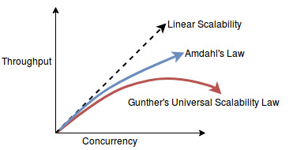
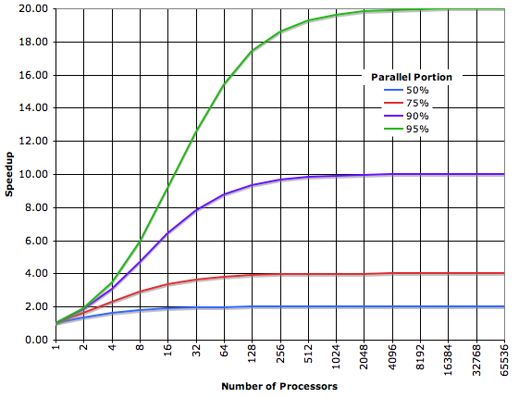
Amdahl’s Law
“Diminishing marginal returns” as we increase the parallelism
Can never actually achieve a linear or super-linear speedup as the amount of parallel workers increases
Not always true in practice - sometimes we do get super-linear speedup.
In general: can run many heterogeneous machines in parallel in a cluster.
CPUs
Many parallel cores
Deep parallel cache hierarchies – taking up most of the area
Often many parallel CPU sockets in a machine
GPUs
Can run way more numerical computations in parallel than a CPU
Loads of lightweight cores running together
Gunther’s Law: effect of coherency delay
Notes:
Ajouter une photo d’un vieux telegraphe, puis un mobile satellitte ancienne generation…can someone find an even older wireless communication system (smoke)

Slide 10
Sources of Parallelism
On CPUs
Instruction-Level Parallelism
Single-Instruction Multiple-Data (SIMD) / Vector parallelism
Multi-core parallelism (significant cost to synchronize)
Multi-socket parallelism / NUMA (Non-Uniform Memory Access)
On GPUs
Stream processing
On specialized accelerators and ASICs
Various options, only limited by the available transistors
Distributed Setting
Many workers communicate over a network
Possibly heterogeneous workers including CPUs, GPUs, and ASICs
Usually no shared memory abstraction
Workers communicate explicitly through passing messages
Latency much higher than all other types of parallelism
Often need fundamentally different algorithms to handle this
Fine-grained
Coarse-grained
Notes:
Ajouter une photo d’un vieux telegraphe, puis un mobile satellitte ancienne generation…can someone find an even older wireless communication system (smoke)

Slide 11



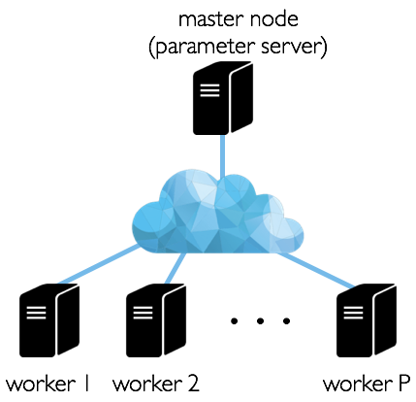

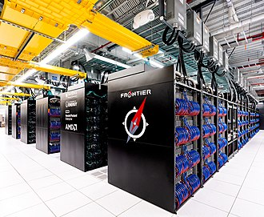
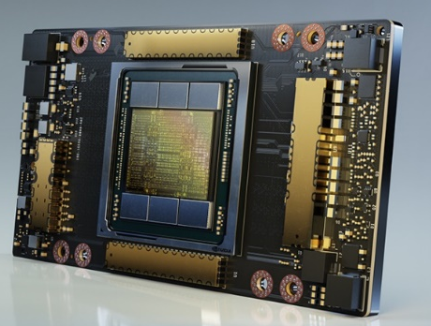
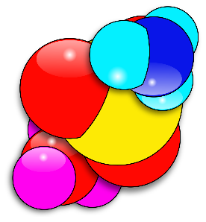
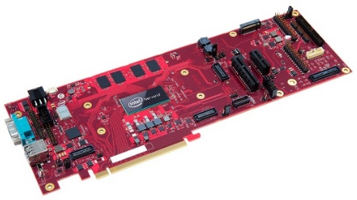


Modern Computation Paradigms
Smartphones
~11 TFLOPs
FLOP: Floating point operations per second
1 Peta (10¹⁵) = 1000 Tera = 10⁶ Giga
Specialized Hardware
Focus on subset of operations
GPU (Graphical Processing Unit), FPGA (Field Programmable Gated Array)
~10 TFLOPs
Distributed Computation
474 Peta FLOPS
Large (“single”) Computers
1.102 exaFLOPs
See: www.top500.org
NVIDIA A100 GPU
HPE Frontier OLCF-5
Intel Springhill
Notes:
Ajouter une photo d’un vieux telegraphe, puis un mobile satellitte ancienne generation…can someone find an even older wireless communication system (smoke)

Slide 12
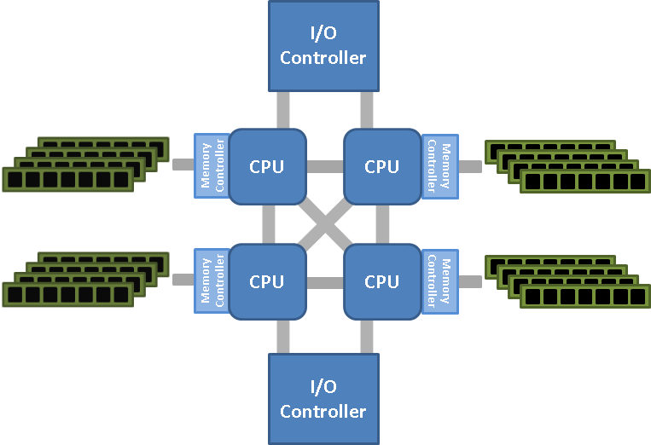
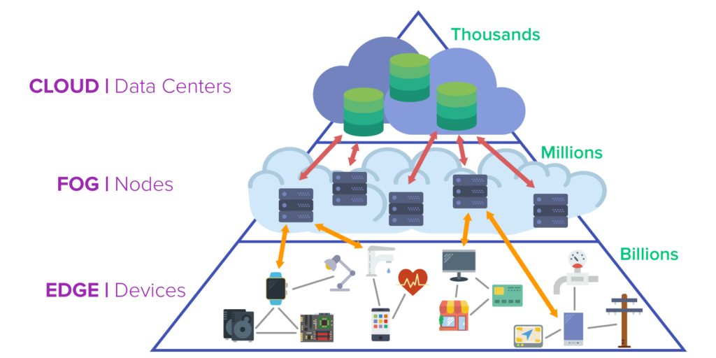
Speeding up ML
Parallel
Multi-socket NUMA
Single machine, multicore
NUMA: non-uniform memory access
Distributed

Slide 13
Parallel vs. Distributed
Parallel
Single machine, many cores (usually up to100s)
Shared memory
(all cores have access to RAM)
Communication costs to RAM: low
Distributed
Many machines (usually up to1000s) connected via network
Shared-nothing architecture
(each node has its own resources)
Communication costs: non-negligible
Scaling up vs. Scaling out
Notes:
Ajouter une photo d’un vieux telegraphe, puis un mobile satellitte ancienne generation…can someone find an even older wireless communication system (smoke)

Slide 14
Scaling up vs. Scaling out
What we’d ideally like:
Cores
Memory (RAM)
Communication Cost
Cost to build
Feasible solutions:
Scaling up: Getting the largest machine possible, with maxed out RAM
Scaling out: Getting a bunch of machines, and linking them together
Scaling up
Pros
RAM communication cheap (no network)
Less implementation overheads
Smaller power/smaller footprint
Cons
100s cores/machine = expensive
Smaller fault tolerance
Limited upgradability
Scaling out
Pros
Much cheaper (especially on EC2)
Can replace faulty parts
Better fault tolerance (if it matters)
Cons
Network bound
Major implementation overheads
Large power footprint

Slide 15
Distributed Machine Learning
Main idea: use multiple machines to do learning
Why distribute?
Train more quickly
Train models too large to fit on one machine
Train when data are inherently distributed
Distributed ML/Computing
Involves 2 or more machines collaborating on a single* task by communicating over a network.
Requires explicit (i.e., written in software) communication among the workers.
No shared memory abstraction! (Unlike parallelism on 1 machine)
Key Principle: Overlapping Computation and Communication
Communicating over the network results in high latency
For best performance: workers still be doing useful work while communication is going on
rather than having to stop and wait for the communication to finish (stall)
asynchronous communication may help a lot here
Notes:
Ajouter une photo d’un vieux telegraphe, puis un mobile satellitte ancienne generation…can someone find an even older wireless communication system (smoke)

Slide 16
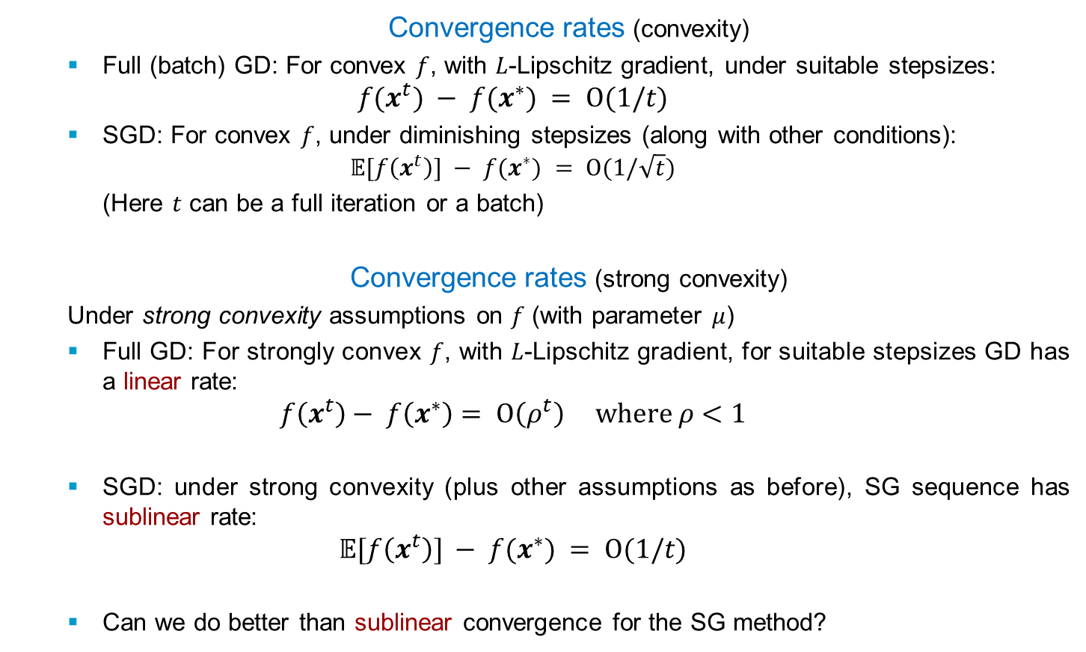
Recap: GD vs. SGD in a Nutshell
Convergence rates (convexity)
Full (batch) GD: For convex $f$, with $L$-Lipschitz gradient, under suitable stepsizes:
$$f(x^{t}) − f(x^{∗}) = O(1/t)$$
SGD: For convex $f$, under diminishing stepsizes (along with other conditions):
$$𝔼[f\left(x^{t}\right)] − f(x^{∗}) = O(1/\sqrt{t})$$
(Here $t$ can be a full iteration or a batch)
Convergence rates (strong convexity)
Under strong convexity assumptions on $f$ (with parameter $μ$)
Full GD: For strongly convex $f$, with $L$-Lipschitz gradient, for suitable stepsizes GD has a linear rate:
$$f\left(x^{t}\right)− f\left(x^{∗}\right)= O\left(ρ^{t}\right) where ρ<1$$
SGD: under strong convexity (plus other assumptions as before), SG sequence has sublinear rate:
$$𝔼[f\left(x^{t}\right)] − f(x^{∗}) = O(1/t)$$
Can we do better than sublinear convergence for the SG method?
Notes:
Ajouter une photo d’un vieux telegraphe, puis un mobile satellitte ancienne generation…can someone find an even older wireless communication system (smoke)

Slide 17
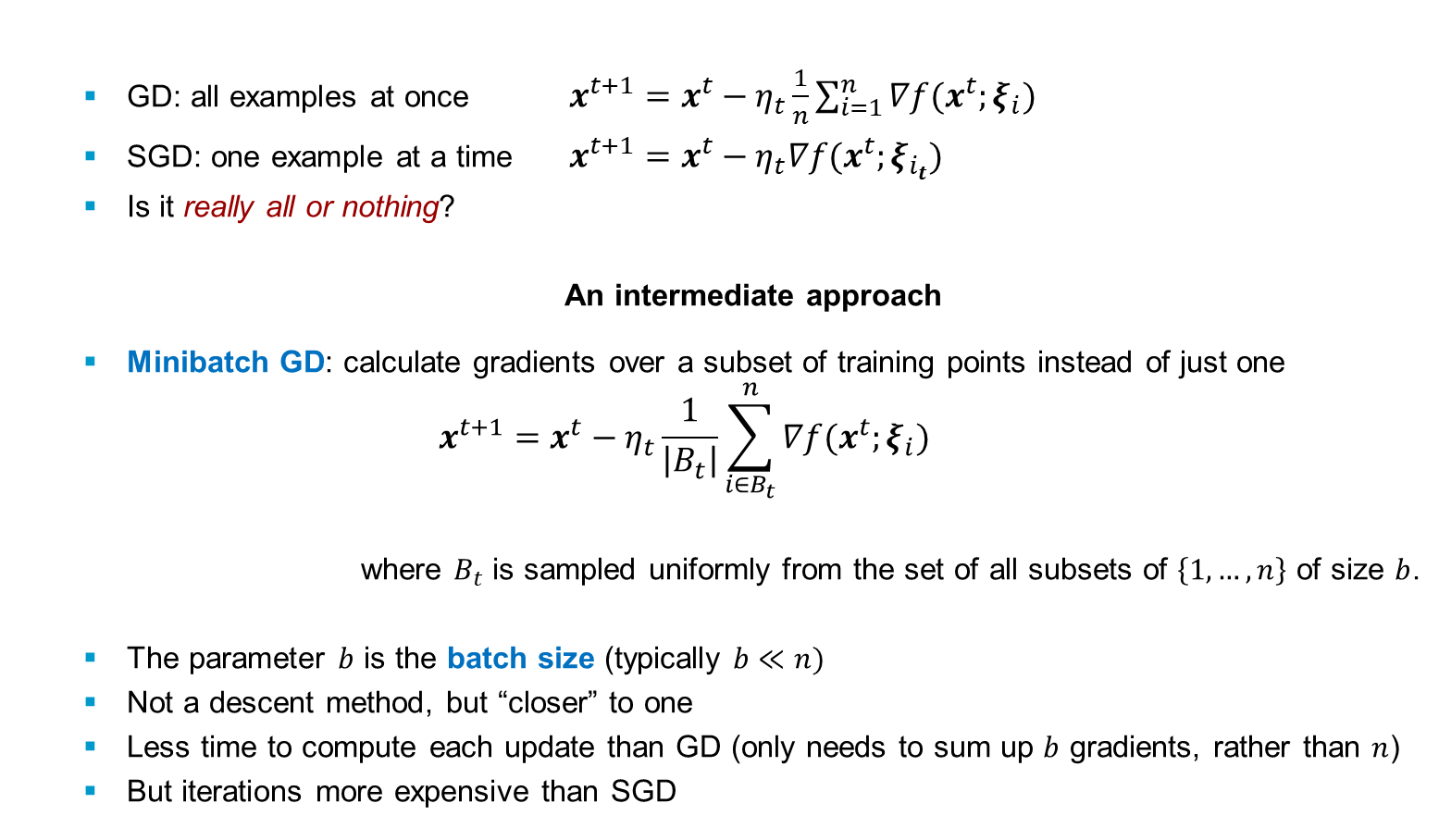
Minibatch Gradient Descent
GD: all examples at once $x^{t+1}=x^{t}−η_{t}\frac{1}{n}\sum_{i=1}^{n}{∇f(x^{t};ξ_{i})}$
SGD: one example at a time $x^{t+1}=x^{t}−η_{t}∇f(x^{t};ξ_{i_{t}})$
Is it really all or nothing?
An intermediate approach
Minibatch GD: calculate gradients over a subset of training points instead of just one
$$x^{t+1}=x^{t}−η_{t}\frac{1}{\left|B_{t}\right|}\sum_{i∈B_{t}}^{n}{∇f(x^{t};ξ_{i})}$$
where $B_{t}$ is sampled uniformly from the set of all subsets of $\left\{1, …, n\right\}$ of size $b$.
The parameter $b$ is the batch size (typically $b≪n)$
Not a descent method, but “closer” to one
Less time to compute each update than GD (only needs to sum up $b$ gradients, rather than $n$)
But iterations more expensive than SGD
Notes:
Ajouter une photo d’un vieux telegraphe, puis un mobile satellitte ancienne generation…can someone find an even older wireless communication system (smoke)

Slide 18
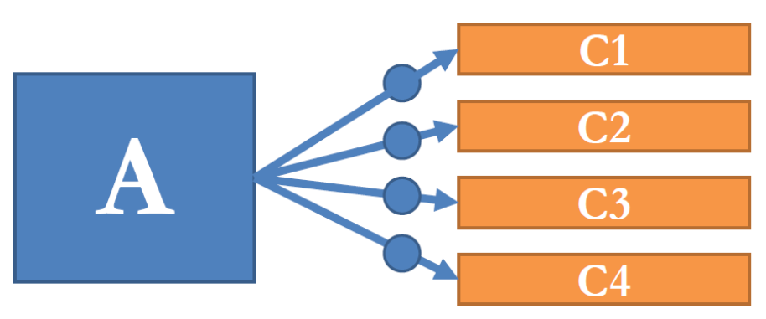
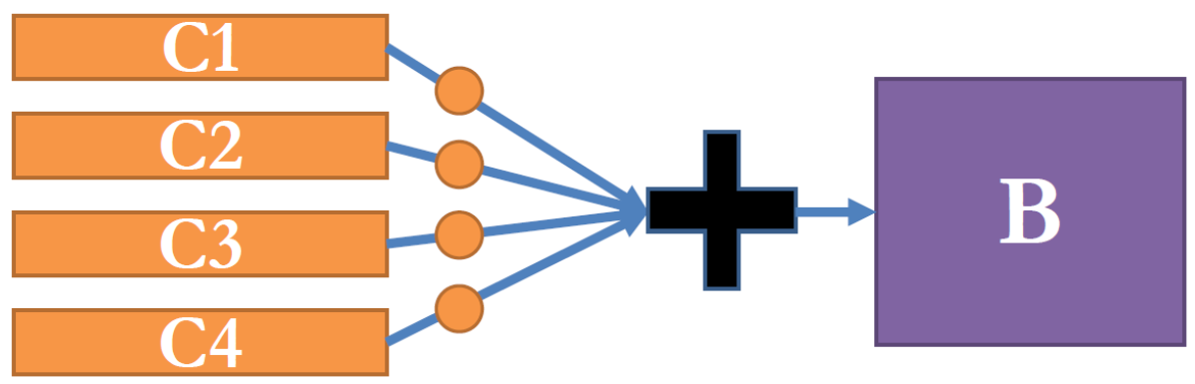
Basic patterns of distributed communication
Broadcast: Machine A sends
data to many machines
Reduce: Compute some reduction of data on multiple machines and materialize result on B
All-reduce: Compute some reduction of data on multiple machines and materialize result on all those machines.
Notes:
Ajouter une photo d’un vieux telegraphe, puis un mobile satellitte ancienne generation…can someone find an even older wireless communication system (smoke)

Slide 19
Basic patterns of distributed communication
Push: Machine A sends
some data to machine B
Pull: Machine A requests
some data from machine B
Wait: Pause until another
machine says to continue
Barrier: Wait for all workers to
reach some point in their code
Notes:
Ajouter une photo d’un vieux telegraphe, puis un mobile satellitte ancienne generation…can someone find an even older wireless communication system (smoke)

Slide 20
Distributed ML Models
Centralized
Distributed
Decentralized
ML in the cloud with “dumb” end-user devices
All data is in the cloud/edge
Inference and decision making in the cloud/edge
No data privacy
ML in the cloud + on-user-device ML
Only part of the data is in the cloud/edge
Use the cloud/edge but smartly
Privacy-preserving (e.g., federated learning)
No infrastructure (e.g., cloud) needed
Data fully distributed
Collaborative intelligence
Privacy-preserving
(sharing models instead of data)
Notes:
Ajouter une photo d’un vieux telegraphe, puis un mobile satellitte ancienne generation…can someone find an even older wireless communication system (smoke)

Slide 21
Parallelism in Distributed Machine Learning
Data parallelism
Replicate the model on each machine
Divide data into multiple partitions
Then respectively train copies of the model in parallel with their own allocated data samples.
Efficiency of model training can be improved.
Most common approach: typically preferable in terms of implementation, fault tolerance, and parallelizability
Model parallelism
Replicate the data on each machine
First split a large ML model into multiple parts
Then feed data samples for training these segmented models in parallel.
Improved training speed
Resolve issues when the model is larger than the device memory.
Attractive approach for massive models
Notes:
Ajouter une photo d’un vieux telegraphe, puis un mobile satellitte ancienne generation…can someone find an even older wireless communication system (smoke)

Slide 22
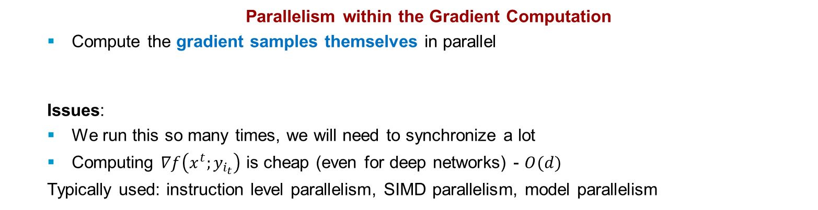
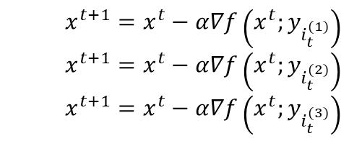
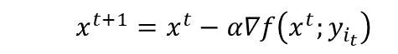
How to Parallelize and Distribute SGD?
Parallelism within the Gradient Computation
Compute the gradient samples themselves in parallel
Issues:
We run this so many times, we will need to synchronize a lot
Computing $∇f\left(x^{t};y_{i_{t}}\right)$ is cheap (even for deep networks) - $O(d)$
Typically used: instruction level parallelism, SIMD parallelism, model parallelism
$$x^{t+1}=x^{t}−α∇f\left(x^{t};y_{i_{t}}\right)$$
Parallelism across Iterations
Compute multiple iterations of SGD in parallel – Parallelize the outer loop
Issues:
all gradients computed on the same model
Outer loop is sequential – need for fine-grained locking and frequent synchronization
Typically used: multi-core/multi-socket/cluster parallelism
$$x^{t+1}=x^{t}−α∇f\left(x^{t};y_{i_{t}^{(1)}}\right)$$
$$x^{t+1}=x^{t}−α∇f\left(x^{t};y_{i_{t}^{(2)}}\right)$$
$$x^{t+1}=x^{t}−α∇f\left(x^{t};y_{i_{t}^{(3)}}\right)$$
Notes:
Ajouter une photo d’un vieux telegraphe, puis un mobile satellitte ancienne generation…can someone find an even older wireless communication system (smoke)

Slide 23
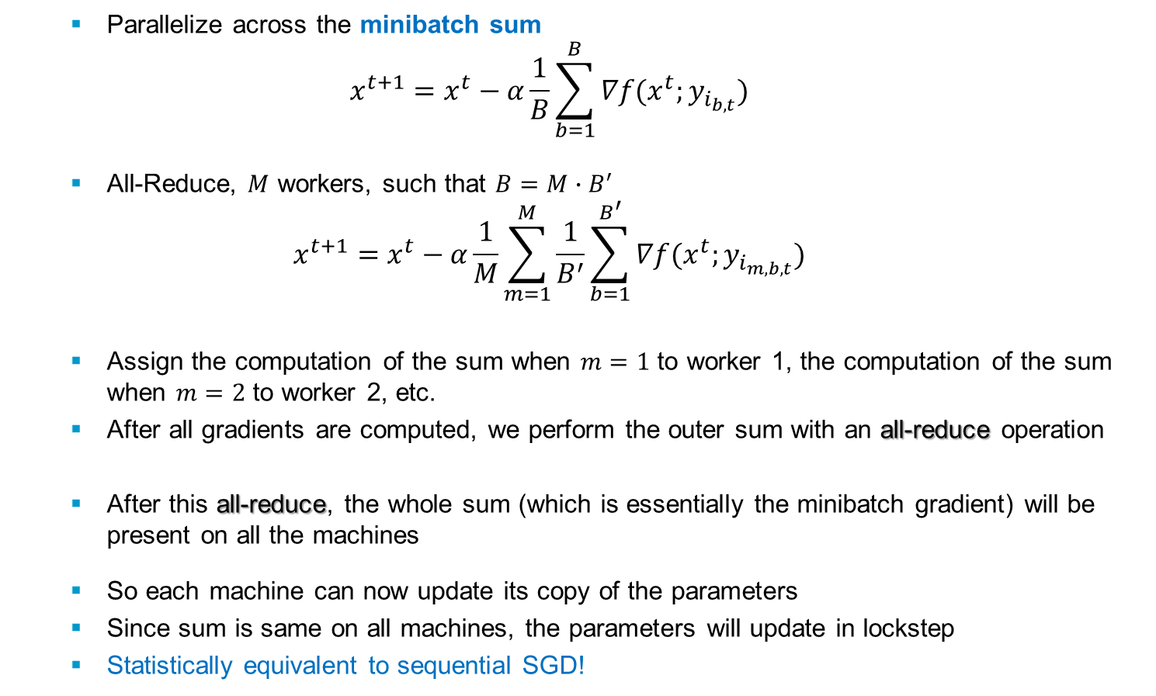
Parallelism with Minibatching
Parallelize across the minibatch sum
$$x^{t+1}=x^{t}−α\frac{1}{B}\sum_{b=1}^{B}{∇f(x^{t};y_{i_{b,t}})}$$
All-Reduce, $M$ workers, such that $B=M∙B^{′}$
$$x^{t+1}=x^{t}−α\frac{1}{M}\sum_{m=1}^{M}{\frac{1}{B^{′}}}\sum_{b=1}^{B^{′}}{∇f(x^{t};y_{i_{m,b,t}})}$$
Assign the computation of the sum when $m=1$ to worker 1, the computation of the sum when $m=2$ to worker 2, etc.
After all gradients are computed, we perform the outer sum with an all-reduce operation
After this all-reduce, the whole sum (which is essentially the minibatch gradient) will be present on all the machines
So each machine can now update its copy of the parameters
Since sum is same on all machines, the parameters will update in lockstep
Statistically equivalent to sequential SGD!
Notes:
Ajouter une photo d’un vieux telegraphe, puis un mobile satellitte ancienne generation…can someone find an even older wireless communication system (smoke)

Slide 24
Distributed Minibatch SGD with All-Reduce
Pros
The algorithm is easy to reason about, since it’s statistically equivalent to minibatch SGD
and we can use the same hyperparameters for the most part
The algorithm is easy to implement
since all worker machines have the same role and runs on top of standard distributed computing primitives
Cons
We’re not overlapping computation and communication.
While the communication for the all-reduce is happening, the workers are idle
The effective minibatch size is growing with the number of machines
If we don’t want to run with a large minibatch size for statistical reasons, this can prevent us from scaling to large numbers of machines using this method
Potentially requires lots of network bandwidth to communicate to all workers
Issues:
Still run this so many times, we need to synchronize a lot
Can have a tradeoff with statistical efficiency, since too much minibatching can harm convergence
Typically used: all types of parallelism
Notes:
Ajouter une photo d’un vieux telegraphe, puis un mobile satellitte ancienne generation…can someone find an even older wireless communication system (smoke)

Slide 25
Training Examples in Distributed ML
Where do we get the training examples from?
Training data servers
Have one or more non-worker servers dedicated to storing the training examples (e.g., a distributed in-memory filesystem)
The worker machines load training examples from those servers.
Partitioned dataset
Partition the training examples among the workers themselves and store them locally in memory on the workers.
Notes:
Ajouter une photo d’un vieux telegraphe, puis un mobile satellitte ancienne generation…can someone find an even older wireless communication system (smoke)

Slide 26
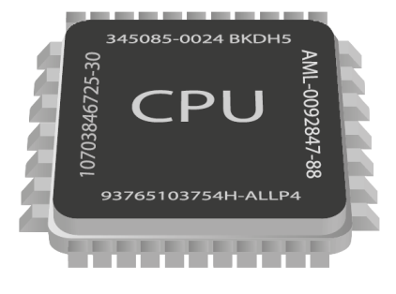





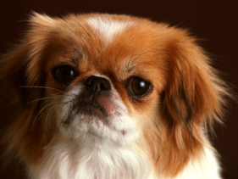



Distribute the Effort
Several Issues
Theory
Minibatch SGD vs. 1- sample SGD
Many models weaker than 1
Delays and Slow Nodes
Communication Costs
Practice
Barriers to entry / High Cost
Implementation overhead
Nontrivial choice of ML framework
Algos & Architectures
Downpour SGD
Hogwild!
Delay-tolerant Algos for SGD
TensorFlow
Elastic Averaging SGD
Notes:
Ajouter une photo d’un vieux telegraphe, puis un mobile satellitte ancienne generation…can someone find an even older wireless communication system (smoke)

Slide 27
Asynchronous Parallelism
SGD is inherently a sequential algorithm
If we run it step-by-step: good convergence but slow
If we run it asynchronously: faster but suboptimal comm. among workers can lead to poor convergence
Limits of Parallel Performance
Synchronization: need to synchronize to keep the workers aware of each other’s updates to the model – otherwise can introduce errors
Synchronization can be very expensive
Have to stop all the workers and wait for the slowest one
Have to wait for several round-trip times through a high-latency channel
How about just don’t synchronize?
Not synchronizing adds errors
But our methods are noisy (already) – maybe these errors are fine
If we don’t synchronize, get almost perfect parallel speedup
Notes:
Ajouter une photo d’un vieux telegraphe, puis un mobile satellitte ancienne generation…can someone find an even older wireless communication system (smoke)

Slide 28
Parameter Server Model
A single machine (PS) has the explicit responsibility of storing/maintaining the current value of the parameters.
Stores the model

Slide 29
Parameter Server Model
PS updates its parameters by using gradients that are computed by the workers, and pushed to the PS
Each worker computes gradients on minibatches of the data
Gradient Computations

Slide 30
Parameter Server Model
Periodically
PS broadcasts its updated parameters to all other worker machines, so that they can use the updated parameters to compute gradients.
Workers pull an update copy of the weights from the PS
All this can be done
synchronously or asynchronously

Slide 31
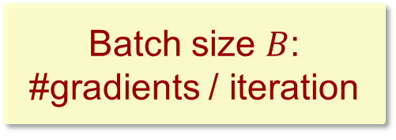
Parameter Server Model
Batch size $B$:
#gradients / iteration
+
+
+

Slide 32
Parameter Server Model

Slide 33
Parameter Server Model

Slide 34
Parameter Server Model
Repeat distributed iterations until
happy with the model

Slide 35
Parameter Server Model
Two options when learning with a PS
Synchronous distributed training
Similar to All-reduce, but with gradients summed on a central parameter server
Still equivalent to sequential minibatch SGD
Asynchronous distributed training
Compute and send gradients & add them to the model as soon as possible
Broadcast updates whenever they are available
Multiple Parameter Servers
Use multiple PS machines when the parameters are too many for a single PS to handle
We partition the parameters among the multiple PSs
Each server is only responsible for maintaining the parameters in its partition
When a worker wants to send a gradient, it will partition that gradient vector and send each chunk to the corresponding PS
Later, the worker will receive the corresponding chunk of the updated model from that PS machine
This lets us scale up to very large models!
Notes:
Ajouter une photo d’un vieux telegraphe, puis un mobile satellitte ancienne generation…can someone find an even older wireless communication system (smoke)

Slide 36
Other Ways to Distribute
Decentralized learning
Idea: learn without any central coordination
No parameter server; each worker has its own copy of the model
Workers update by doing the following:
Run an SGD update step using an example stored on that worker,
Average its current model with the model(s) of some other workers, usually its neighbors in some sparse graph
This limits total communication
Sometimes called a gossip algorithm
Local SGD
Many parallel workers update their own copy of the model by running SGD steps using their own local data
Periodically the workers average by taking an all-reduce step
Like all-reduce SGD, but the all-reduce happens less frequently than at every SGD iteration
Can generalize better than large-batch SGD
“Don’t use large minibatches, use local SGD” ICLR 2020
Notes:
Ajouter une photo d’un vieux telegraphe, puis un mobile satellitte ancienne generation…can someone find an even older wireless communication system (smoke)

Slide 37
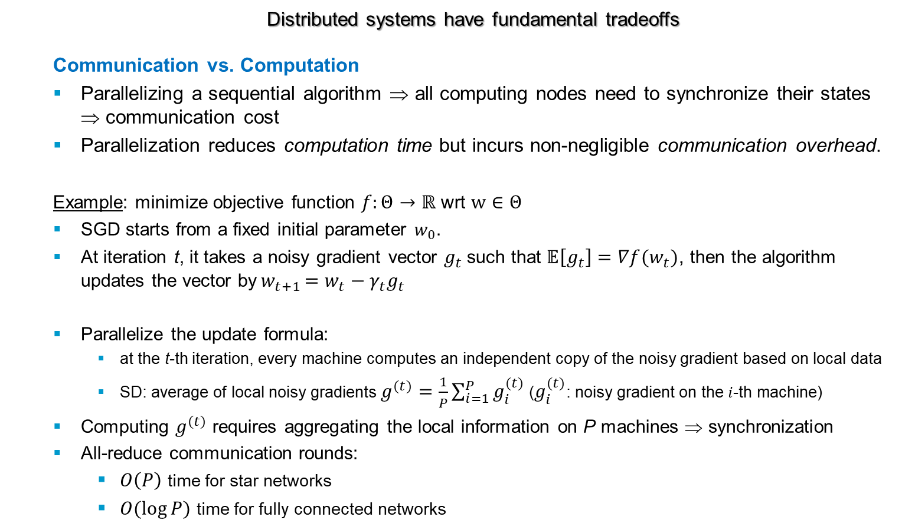
Tradeoffs in Distributed Computing/ML
Distributed systems have fundamental tradeoffs
Communication vs. Computation
Parallelizing a sequential algorithm ⇒ all computing nodes need to synchronize their states ⇒ communication cost
Parallelization reduces computation time but incurs non-negligible communication overhead.
Example: minimize objective function $f:Θ→ℝ$ wrt $w∈Θ$
SGD starts from a fixed initial parameter $w_{0}$.
At iteration t, it takes a noisy gradient vector $g_{t}$such that $𝔼\left[g_{t}\right]=∇f(w_{t})$, then the algorithm updates the vector by${ w}_{t+1 }=w_{t}−γ_{t}g_{t}$
Parallelize the update formula:
at the t-th iteration, every machine computes an independent copy of the noisy gradient based on local data
SD: average of local noisy gradients $g^{(t)}=\frac{1}{P}\sum_{i=1}^{P}{g_{i}^{(t)}}$ ($g_{i}^{(t)}$: noisy gradient on the $i$-th machine)
Computing $g^{(t)}$ requires aggregating the local information on P machines ⇒ synchronization
All-reduce communication rounds:
$O\left(P\right)$ time for star networks
$O(\log{P})$ time for fully connected networks
Notes:
Ajouter une photo d’un vieux telegraphe, puis un mobile satellitte ancienne generation…can someone find an even older wireless communication system (smoke)

Slide 38
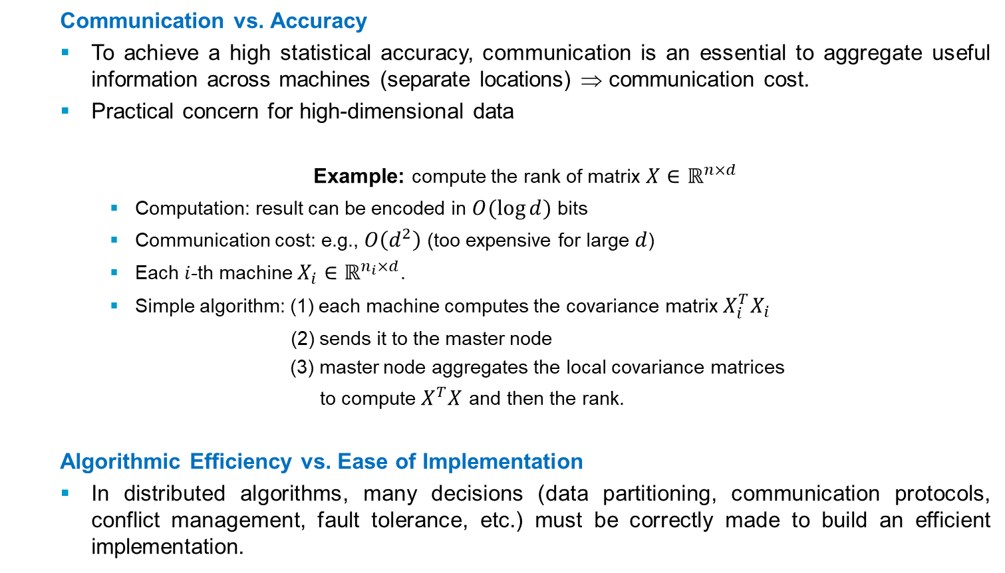
Tradeoffs in Distributed Computing/ML
Communication vs. Accuracy
To achieve a high statistical accuracy, communication is an essential to aggregate useful information across machines (separate locations) ⇒ communication cost.
Practical concern for high-dimensional data
Example: compute the rank of matrix $X∈ℝ^{n×d}$
Computation: result can be encoded in $O(\log{d})$ bits
Communication cost: e.g., $O\left(d^{2}\right)$ (too expensive for large $d$)
Each $i$-th machine $X_{i}∈ℝ^{n_{i}×d}$.
Simple algorithm: (1) each machine computes the covariance matrix ${X_{i}^{T}X}_{i}$
(2) sends it to the master node
(3) master node aggregates the local covariance matrices
to compute $X^{T}X$ and then the rank.
Algorithmic Efficiency vs. Ease of Implementation
In distributed algorithms, many decisions (data partitioning, communication protocols, conflict management, fault tolerance, etc.) must be correctly made to build an efficient implementation.
Notes:
Ajouter une photo d’un vieux telegraphe, puis un mobile satellitte ancienne generation…can someone find an even older wireless communication system (smoke)

Slide 39
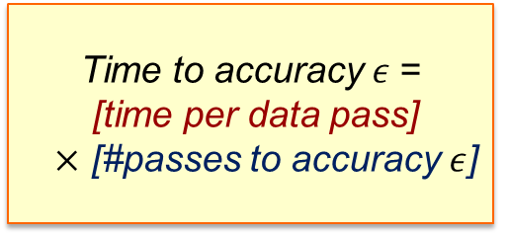
How does distributed ML perform?
Convergence speed of minibatch SGD?
How can we measure speed-ups?
Communication is expensive ⇒ how often do we average?
How do we choose the right model?
What happens with delayed nodes (stragglers)?
Fault tolerance? Robustness?
…
Optimal speed-up
Reality ~ 100x worse than optimal…Why so slow?
Two factors control run-time
Time to accuracy $ε$=
[time per data pass]
$×$ [#passes to accuracy $ε$]
Notes:
Ajouter une photo d’un vieux telegraphe, puis un mobile satellitte ancienne generation…can someone find an even older wireless communication system (smoke)

Slide 40
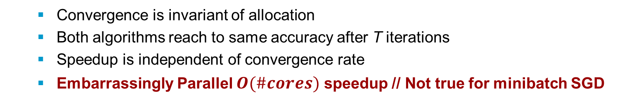
How to analyze Parallel Algorithms
Main measure of performance
$$Speedup=\frac{Time of serial 𝒜 to accuracy ε}{Time of parallel 𝒜 to accuracy ε}$$
Example: Gradient Descent
Serial
Parallel
Convergence is invariant of allocation
Both algorithms reach to same accuracy after T iterations
Speedup is independent of convergence rate
Embarrassingly Parallel $O(\#cores)$ speedup // Not true for minibatch SGD
Notes:
Ajouter une photo d’un vieux telegraphe, puis un mobile satellitte ancienne generation…can someone find an even older wireless communication system (smoke)

Slide 41
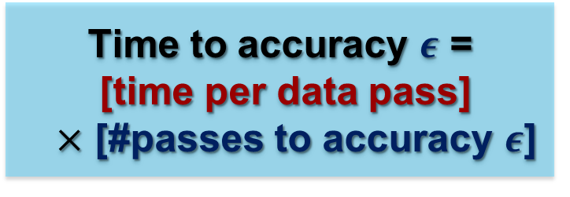
How to evaluate Minibatch SGD?
Measure of performance
How to evaluate run-time?
Time to accuracy $ε$ =
[time per data pass]
$×$ [#passes to accuracy $ε$]
Minibatch SGD vs. serial SGD?
Convergence after T gradient computations?
Notes:
Ajouter une photo d’un vieux telegraphe, puis un mobile satellitte ancienne generation…can someone find an even older wireless communication system (smoke)

Slide 42
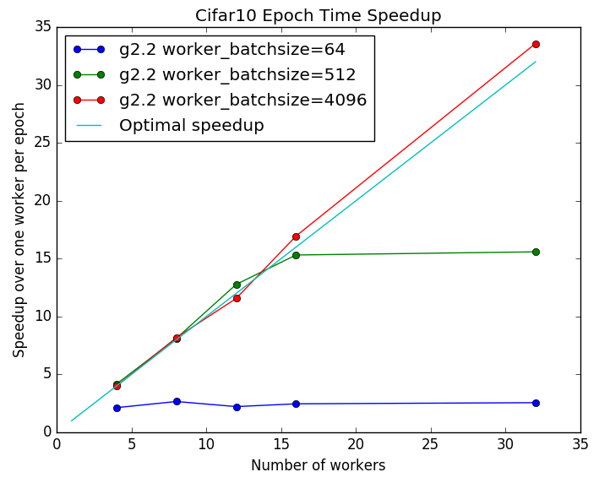
Why so slow?
Speed-up (time for data pass) becomes better with larger B
Communication is the Bottleneck
beyond ~10 machines, network overhead becomes dominant
Time per pass:
time for dataset_size/batch_size
Bigger Batch
⇒ Less Communication
(smaller time per epoch)
Notes:
Ajouter une photo d’un vieux telegraphe, puis un mobile satellitte ancienne generation…can someone find an even older wireless communication system (smoke)

Slide 43
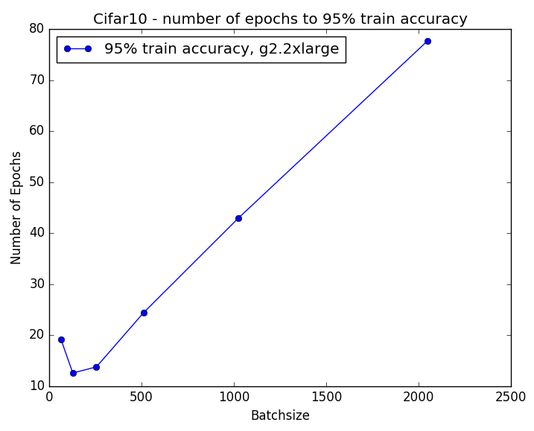
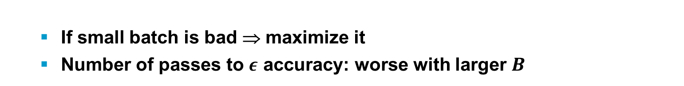
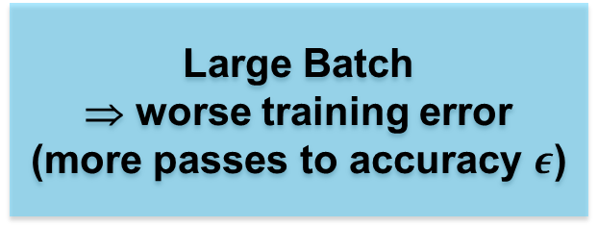
How about Larger Batches?
If small batch is bad ⇒ maximize it
Number of passes to $ε$ accuracy: worse with larger $B$
Large Batch
⇒ worse training error
(more passes to accuracy $ε$)
Large Batch
⇒ worse generalization
Notes:
Ajouter une photo d’un vieux telegraphe, puis un mobile satellitte ancienne generation…can someone find an even older wireless communication system (smoke)

Slide 44
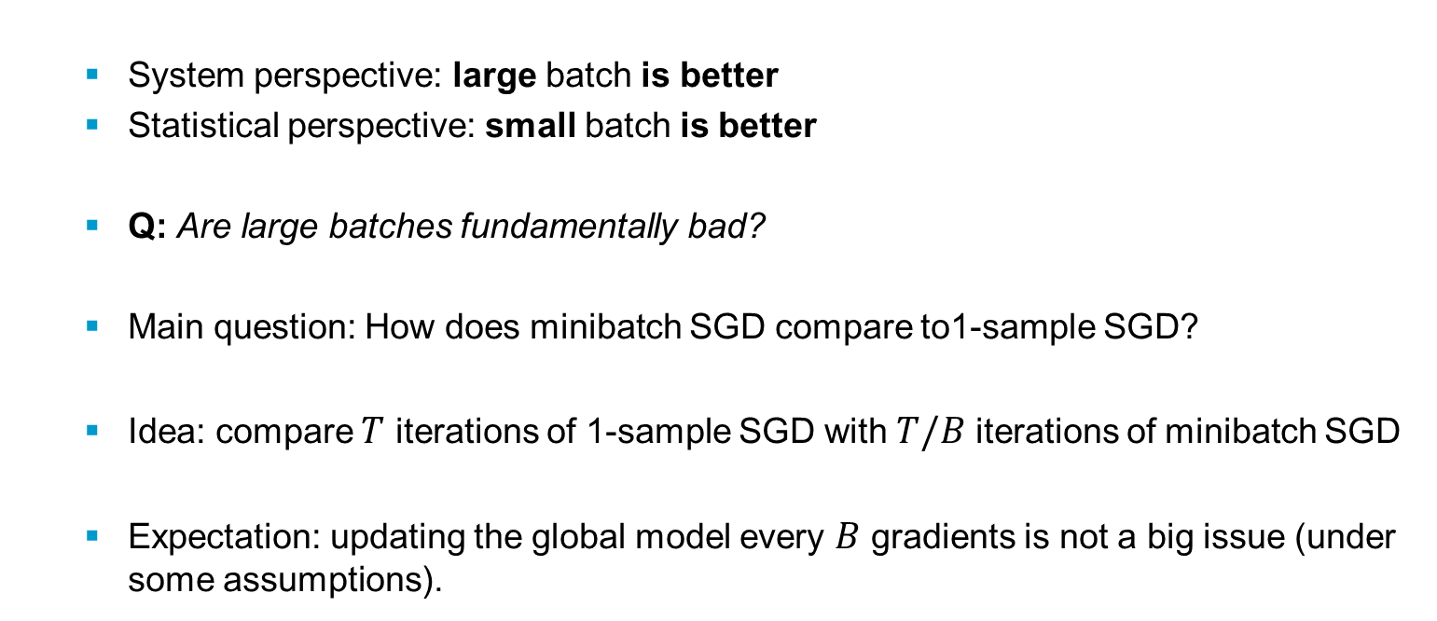
Convergence of Minibatch SGD
System perspective: large batch is better
Statistical perspective: small batch is better
Q: Are large batches fundamentally bad?
Main question: How does minibatch SGD compare to1-sample SGD?
Idea: compare $T$ iterations of 1-sample SGD with $T/B$ iterations of minibatch SGD
Expectation: updating the global model every $B$ gradients is not a big issue (under some assumptions).
Notes:
Ajouter une photo d’un vieux telegraphe, puis un mobile satellitte ancienne generation…can someone find an even older wireless communication system (smoke)

Slide 45
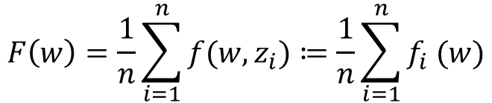
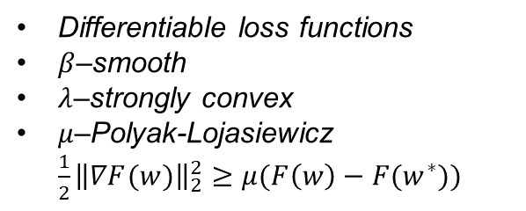
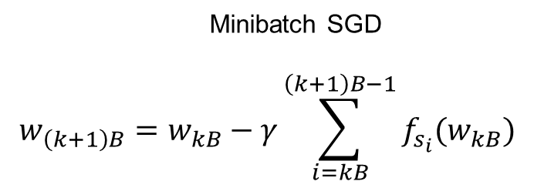
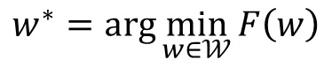
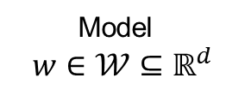
Minibatch SGD - Setup
Supervised learning - Empirical Risk Minimization
Model
$$w∈𝒲⊆ℝ^{d}$$
$$F\left(w\right)=\frac{1}{n}\sum_{i=1}^{n}{f(w,z_{i})}≔\frac{1}{n}\sum_{i=1}^{n}{f_{i} (w)}$$
$$w^{∗}=arg\min_{w∈𝒲}{F\left(w\right)}$$
Differentiable loss functions
$β$–smooth
$λ$–strongly convex
$μ$–Polyak-Lojasiewicz
$\frac{1}{2}{\left\|∇F(w)\right\|}_{2}^{2}≥μ(F\left(w\right)−F(w^{∗}))$
Minibatch SGD
$$w_{\left(k+1\right)B}=w_{kB}−γ\sum_{i=kB}^{\left(k+1\right)B−1}{f_{s_{i}}(w_{kB})}$$
Notes:
Ajouter une photo d’un vieux telegraphe, puis un mobile satellitte ancienne generation…can someone find an even older wireless communication system (smoke)

Slide 46
Single iteration of 1-sample SGD
Progress in a single iteration:
When minibatch SGD “works”, we expect $B$ times more progress!
Notes:
Ajouter une photo d’un vieux telegraphe, puis un mobile satellitte ancienne generation…can someone find an even older wireless communication system (smoke)

Slide 47
Single iteration of B-sample SGD
Progress in a single minibatch iteration:
How does it compare in expectation with 1-sample SGD?
Notes:
Ajouter une photo d’un vieux telegraphe, puis un mobile satellitte ancienne generation…can someone find an even older wireless communication system (smoke)

Slide 48
Single iteration of B-sample SGD
Progress is equal to:
Variance is equal to:
Notes:
Ajouter une photo d’un vieux telegraphe, puis un mobile satellitte ancienne generation…can someone find an even older wireless communication system (smoke)

Slide 49
Minibatch SGD vs. SGD Progress
1-sample SGD Progress:
$B$-sample SGD Progress:
“Extra variance” term directly controlled by $B$
Simple idea: Set $B$ so that the extra term is smaller than
Notes:
Ajouter une photo d’un vieux telegraphe, puis un mobile satellitte ancienne generation…can someone find an even older wireless communication system (smoke)

Slide 50
Minibatch SGD vs. SGD Progress
If
We get
1- sample SGD gets:
$B$ times more progress! (approximately)
Notes:
Ajouter une photo d’un vieux telegraphe, puis un mobile satellitte ancienne generation…can someone find an even older wireless communication system (smoke)

Slide 51
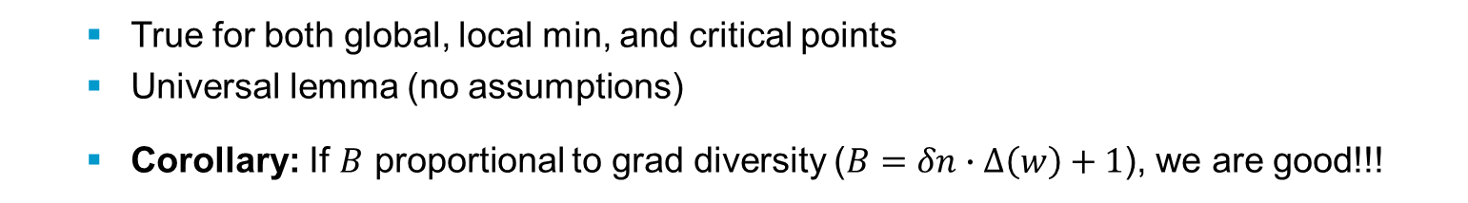
Gradient Diversity
Gradient Diversity:
Key Result
True for both global, local min, and critical points
Universal lemma (no assumptions)
Corollary: If $B$ proportional to grad diversity ($B=δn∙Δ\left(w\right)+1$), we are good!!!
Notes:
Ajouter une photo d’un vieux telegraphe, puis un mobile satellitte ancienne generation…can someone find an even older wireless communication system (smoke)

Slide 52
Gradient Diversity
Measures similarity between gradients
Big Diversity: Larger batches ⇒ better speedups
Small Diversity: Smaller Batches ⇒ worse speedup
Minibatch SGD: If batch size is beyond a threshold (proportional to grad diversity) ⇒ worse accuracy
Gradient diversity controls the distributed performance
Examples:
All gradients are orthogonal, Diversity = 1
All gradients identical, Diversity = 1/n
Large gradient diversity
Small gradient diversity
Notes:
Ajouter une photo d’un vieux telegraphe, puis un mobile satellitte ancienne generation…can someone find an even older wireless communication system (smoke)

Slide 53
Large Batches bring Redundancy
Similarity hurts!
“similar” gradient updates/workload
workers compute identical gradients – useless!
⇒ no speedup
Theorem
Problems with high “workload diversity” are more amenable to parallelization.
Notes:
Ajouter une photo d’un vieux telegraphe, puis un mobile satellitte ancienne generation…can someone find an even older wireless communication system (smoke)

Slide 54
Gradient Diversity in Experiments
CIFAR-10 (CUDA ConvNet)
Smaller diversity ⇒ slower convergence
Mechanisms to increase diversity?
Many questions: generalization? delayed nodes? how often do we average? …
Notes:
Ajouter une photo d’un vieux telegraphe, puis un mobile satellitte ancienne generation…can someone find an even older wireless communication system (smoke)

Slide 55
How to increase diversity?
We want to maximize
Possible ways:
Data pre-processing (similar to preconditioning)
Dropout (e.g., gradient sparsification)
Design deep architectures that suppress interference
Notes:
Ajouter une photo d’un vieux telegraphe, puis un mobile satellitte ancienne generation…can someone find an even older wireless communication system (smoke)

Slide 56
Large Scale Distributed Deep Networks
Limitations of GPU
Speed-up is small when the model does not fit in the GPU memory
Data and parameter reduction are not attractive for large scale ML problems
DistBelief (Google Brain 2011)
Predecessor of Tensorflow
Software framework using computing clusters with 1000s of machines to train large models
Clusters are utilized to asynchronously compute gradients
Not require the problem to be either convex or sparse
Two main methods
(1) Downpour SGD
(2) Sandblaster L-BFGS
Two-level parallelism
(1) Model Parallelism
(2) Data Parallelism
How to train a deep network with billions of parameters
using tens of thousands of CPU cores?
Notes:
Ajouter une photo d’un vieux telegraphe, puis un mobile satellitte ancienne generation…can someone find an even older wireless communication system (smoke)

Slide 57
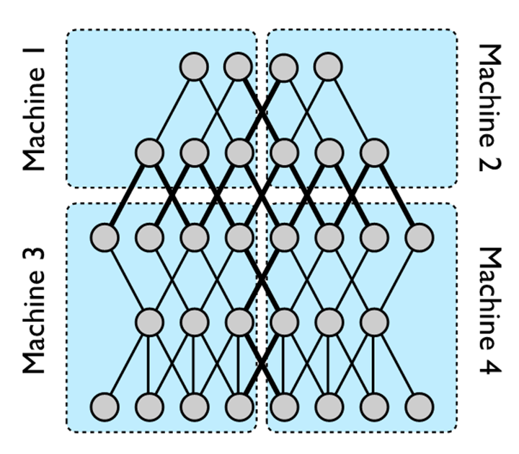
Model Parallelism
A 5 layer DNN with local connectivity is partitioned across 4 machines.
Only nodes with edges that cross partition boundaries (thick lines) need to have their state transmitted between machines.
Even in cases where a node has multiple edges crossing a partition boundary, its state is only sent to the machine on the other side of that boundary once.
Within each partition, computation for individual nodes will thebe parallelized across all available CPU cores.
Notes:
Ajouter une photo d’un vieux telegraphe, puis un mobile satellitte ancienne generation…can someone find an even older wireless communication system (smoke)

Slide 58
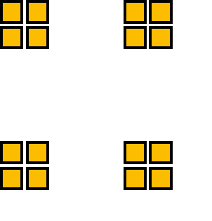
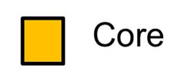
Model Parallelism
DistBelief enables model parallelism
(1) Across machines via message passing (blue box)
(2) Within a machine via multithreading (orange box)
Performance benefits of distributing DNNs across multiple machines depends on
connectivity structure
computational needs of the model.
Models with a large number of parameters or high computational demands typically benefit from access to more CPUs and memory…
… up to the point where communication costs dominate
Model
Machine
Training Data
Notes:
Ajouter une photo d’un vieux telegraphe, puis un mobile satellitte ancienne generation…can someone find an even older wireless communication system (smoke)

Slide 59
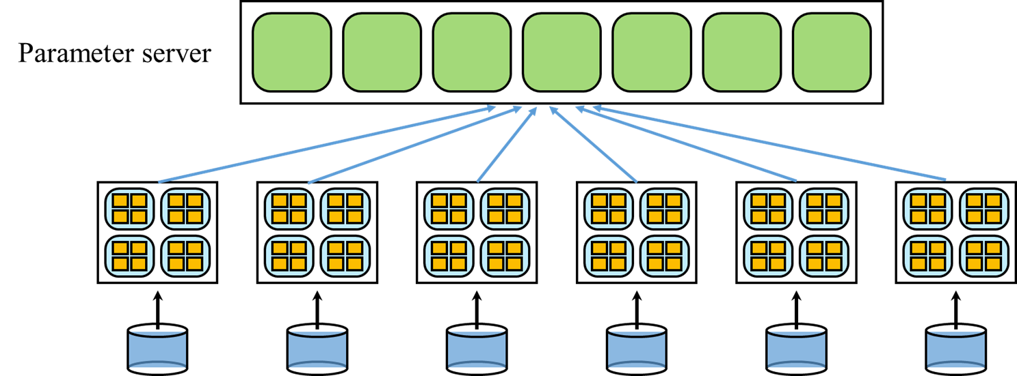
Downpour SGD
A variant of asynchronous SGD
leverages adaptive learning rates and supports a large number of model replicas
Divide training data into a number of subsets and run a copy of the model on each of these subsets
Communicate gradient updates through a centralized parameter server (PS)
Two asynchronous aspects: model replicas and parameter shards run independently
Issues:
Each model replica computes its gradients based on slightly outdated parameters
No guarantee that at any given moment each shard of the PS has undergone the same number of updates
Subtle inconsistencies in the timestamps of parameters
Little theoretical grounding for the safety of these operations, but it works!
Notes:
Ajouter une photo d’un vieux telegraphe, puis un mobile satellitte ancienne generation…can someone find an even older wireless communication system (smoke)

Slide 60



Downpour SGD
$$w’ = w −η∆w$$
$$w’’ = w’ −η∆w’$$
Parameter Server
$$∆w$$
$$∆w’$$
$$w$$
$$w’$$
Model
Model replicas asynchronously fetch parameters $w$
push gradients $∆w$ to the PS
Data
Notes:
Ajouter une photo d’un vieux telegraphe, puis un mobile satellitte ancienne generation…can someone find an even older wireless communication system (smoke)

Slide 61



Downpour SGD
Parameter Server
$$w’ = w −η∆w$$
PS keeps the current state of all model parameters, sharded across many machines
E.g., if we have 10 PS shards, each shard is responsible for storing and applying updates to 1/10th of the model parameters
$$∆w$$
$$w’$$
Model
Workers
Data
Shards
Notes:
Ajouter une photo d’un vieux telegraphe, puis un mobile satellitte ancienne generation…can someone find an even older wireless communication system (smoke)

Slide 62
Sandblaster L-BFGS
Batch optimization orchestration via a single ‘coordinator’ that sends small messages to replicas and the PS
Coordinator
Parameter Server
Sandblaster
Distributed Parameter Storage and Manipulation
The core of the optimization algorithm (e.g. L-BFGS) resides in a coordinator process, which has no direct access to the model parameters.
Coordinator issues commands drawn from a small set of operations (e.g., dot product, scaling, coefficient-wise addition, multiplication) that can be performed by each PS shard independently, with the results being stored locally on the same shard.
Model
Workers
Data
Additional information (e.g. history cache for L-BFGS) is also stored on the PS shard on which it was computed
⇒ large models (billions of parameters) can run without overhead of sending all parameters and gradients to a single central server
Notes:
Ajouter une photo d’un vieux telegraphe, puis un mobile satellitte ancienne generation…can someone find an even older wireless communication system (smoke)

Slide 63

Training Speed-up Performance
Models with more parameters benefit more from the use of additional machines than do models with fewer parameters.
“Large Scale Distributed Deep Networks” [Dean et al., NIPS 2012]
Notes:
Ajouter une photo d’un vieux telegraphe, puis un mobile satellitte ancienne generation…can someone find an even older wireless communication system (smoke)

Slide 64

Accuracy Performance
Training accuracy (on a portion of the training set) for different optimization methods.
Classification accuracy on the hold out test set as a function of training time.
“Large Scale Distributed Deep Networks” [Dean et al., NIPS 2012]
Notes:
Ajouter une photo d’un vieux telegraphe, puis un mobile satellitte ancienne generation…can someone find an even older wireless communication system (smoke)

Slide 65

Time to Accuracy Performance
Resource consumption vs. Performance tradeoff
Time each method took to reach 16% accuracy as a function of machines and utilized CPU cores
Points closer to the origin are preferable in that they take less time while using fewer resources.
Downpour SGD with Adagrad appears to be the best trade-off
“Large Scale Distributed Deep Networks” [Dean et al., NIPS 2012]
Notes:
Ajouter une photo d’un vieux telegraphe, puis un mobile satellitte ancienne generation…can someone find an even older wireless communication system (smoke)

Slide 66


Choosing the Right Model
Some models are better than others,
even from a systems perspective
Does it fit in a single machine?
Is model architecture amenable to low communication?
Some models easier to partition
Can we increase sparsity (less communication) without losing with accuracy?
Notes:
Ajouter une photo d’un vieux telegraphe, puis un mobile satellitte ancienne generation…can someone find an even older wireless communication system (smoke)

Slide 67
The 3+1 Dimensions of ML Performance
Performance Tradeoffs
stat. accuracy
Our algorithms should be here
speed
parallelization
timeliness
Notes:
Ajouter une photo d’un vieux telegraphe, puis un mobile satellitte ancienne generation…can someone find an even older wireless communication system (smoke)

Slide 68

Distributed Learning System Model
Massively large distributed systems with individually small and unreliable computational nodes
“System noise” – anomalous system behavior and bottlenecks
System noise = latency variability (hard to predict)
Bottlenecks
Computation time
Communication load
Batch optimization
Coded: preprocessing, gradient coding
Uncoded: partial computations
Quantization/compression
Sparsification
Local parameter updates
Model compression /Pruning
Robust and Fast Edge Learning over Wireless Networks

